Slide 1
mixed effect models pseudo-replication and heterogeneity
Alejandro Ordonez
Assistant Professor - Department of Bioscience
Section for Ecoinformatics & Biodiversity
Center for Biodiversity Dynamics in a Changing World (BIOCHANGE)

Slide 2
mixed effect models What we will talk about today
The basics of mixed effect models – the mathematical principle
Pseudo-replication – Solving non independence
Nested designs and Random Effects
Model selection – Combing ML and RMEL

Slide 3
Any questions?
Ready to start?

Slide 4
Mixed Effects Models the problem of independence
Observational/experiments can have:
A nested observational/experimental design
samples taken across different spatial-temporal-taxonomic scales
Spatial-Temporal-Evolutionary proximity
Autocorrelation → removes independence between samples
What does this mean?
Samples have “Pseudoreplication”

Slide 5
Mixed Effects Models (Pseudo)replication
Independent observations of same measurement
What is replication?
What is (Pseudo)replication?
Replicates are not independent (spatial-temporal), or “treatments are truly not replicated”
What is independent?
Independent is when the value of one observation does not affect the value of other observations

Slide 6
Independence of observations
What does it mean?
Objects are sampled only once.
The occurrence of one event doesn't change the probability for another.
Sampling of one observation does not affect the choice of the second observation.
How can we ensure independence of observations?
Sample each object only once.
Make sure that replicates have no relation → if they do, they are repetitions.
Use a fully randomized design !!!

Slide 7
(Pseudo)replication
Probably no other aspect of experimental design causes more problems for biologists”
Quinn & Keough (2002) (Experimental Design & Data Analysis for Biologists
Which is the unit of replication in the figure? → Plant or Plot?
û
Plant is unit of replication
2-sample t-test /w 7 replicates
(error df=12)
✓
Plot is unit of replication
2-sample t-test /w 1 replicate
(error df=0)

Slide 8
(Pseudo)replication
Six (6) replicates
Sample structure
Plant NESTED in Plot
Seven (7) repetitions

Slide 9
Addressing (Pseudo)replication Two alternative goals
In a nutshell:
Management of experimental error is all about degrees of freedom budgets
In a nutshell:
Partition the variation goal is to describe how each level/scale determines the the population variance
Management of experimental error
Where does most of the variation occur?
Where would increased replication be most profitable?
Partition the variation across different levels/scales
At which level/scale is most of the variation is generated ?

Slide 10
So far so good?
Any questions?
Ready to move on?

Slide 11
Nested Designs & (Pseudo)replication
What nested design means?
The response varies within more than one level (also known as hierarchical design)
Observations (sites) within regions are not independent

Slide 12
Nested Designs & (Pseudo)replication
Question
What is the effect on the response of changes in X?
But…
We know that the effect of X changes between nine (9) regions
Y_{i} ~ Region_{i,1} + (X_{i,n} * Region_{i,n})

Slide 13
Nested Designs & (Pseudo)replication
This model needs nine (9) parameters to be estimated
We loose 9 degrees of freedom
Losing df → Reduces of inference power!
But in most cases, we don’t care about the region effect
How can we deal with this?
Mixed Effect Models
Allow controlling for regional effects and not loose DF

Slide 14
So far so good?
Any questions?
Ready to move on?

Slide 15
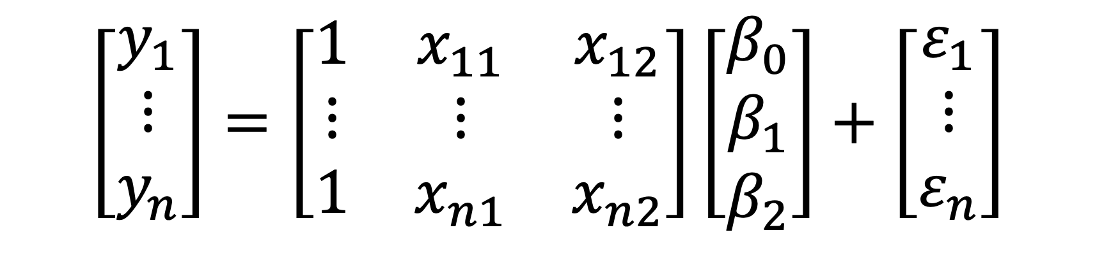
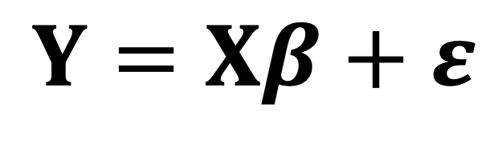
General Linear Models
$$Y=Xβ+ε$$
$$\left[\begin{matrix}y_{1} \\ ⋮ \\ y_{n}\end{matrix}\right]=\left[\begin{matrix}1 & x_{11} & x_{12} \\ ⋮ & ⋮ & ⋮ \\ 1 & x_{n1} & x_{n2}\end{matrix}\right]\left[\begin{matrix}β_{0} \\ β_{1} \\ β_{2}\end{matrix}\right]+\left[\begin{matrix}ε_{1} \\ ⋮ \\ ε_{n}\end{matrix}\right]$$
Fixed part
Error part

Slide 16
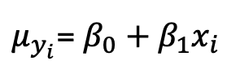
General Linear Model Violating the assumptions
Observations X₁ and X₂ are not independent
Y
$μ_{y_{i}}$= $β_{0}+β_{1}x_{i}$
X₁
X₂
X

Slide 17
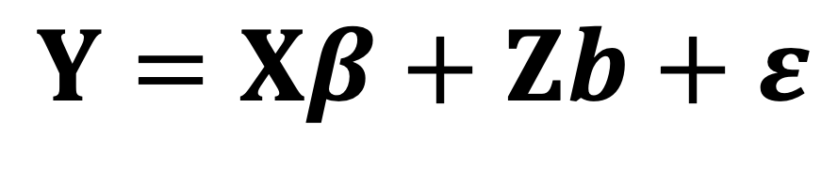
Mixed Effects Models
Intercept only
Intercept and slope
Response
Random effect
$$Y=Xβ+Zb+ε$$
Fixed part
Error part
Fixed effect

Slide 18
Mixed Effects Models
Fixed part
Error part

Slide 19
Mixed Effects Models
Fixed effect
This is how we deal with Pseudoreplication in the experimental design
Random effect
Error part

Slide 20
Mixed Effects Models
Fixed effect
Fixed effects influence only the mean of y
Random effect
Random effects influence only the variance of y
Error part

Slide 21
Mixed Effects Models Fixed vs Random effects
Fixed effects
Levels decided (fixed) by experimenter
If experiment repeated, same levels used again
Not a random sample
Cannot extrapolate to other levels
Random effects
Levels are a random selection of all possible levels
If experiment repeated, different random selection used
Useful to generalise inferences to all possible levels

Slide 22
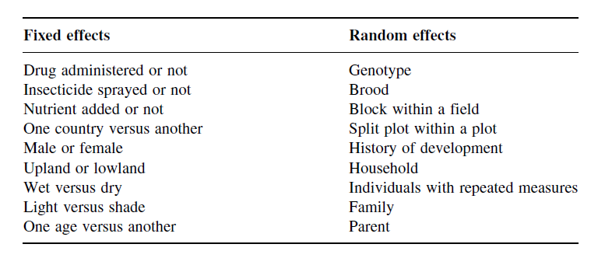
Mixed Effects Models Fixed vs Random effects
Random have
uninformative factor levels
Fixed effects have
informative factor levels
YES
NO
Are factor-levels all possible levels?
Table from Crawley (the R-book) Chp 19, pp 627-630

Slide 23
So far so good?
Any questions?
Ready to move on?

Slide 24
Building Mixed Effects Models in R
Random intercept model
Only intercepts are allowed to vary
Slopes are fixed → the same across different contexts
The mean response is believed to change among groups
Provides information about intra-class correlations
Random slope and intercept model
Both intercepts and the slopes are allowed to vary
Controls for the reduction in Degrees of Freedom
Both the mean response and the rate of change is believed to change among groups

Slide 25
Building Mixed Effects Models in R
Random effect model
The variation in the response variable is only allowed to be described by random effects.
There are NO FIXED EFFECTS!!
Assesses the how the data varies based on the sampling hierarchy → Variance components
Marginal models
The within hierarchy correlation is modelled within the random part of the model
Need to define a specific correlation structure
Observations within a level are correlated

Slide 26
Building Mixed Effects Models in R
Random intercept model
Random slope and intercept model
lme(lme(Y~Fix.Eff,
random=~1|Rand.Eff,
data=data.In)
lme(Y~Fix.Eff,
random=~1+Fix.Eff|Rand.Eff,
data=data.In)
Random effect model
Marginal models
lme(lme(Y~1,
random=~1|Rand.Eff,
data=data.In)
gls(Y~Fix.Eff, correlation=corCompSym(~1|Rand.Eff),
data=data.In)

Slide 27
So far so good?
Any questions?
Ready to move on?

Slide 28
Mixed Effects Models The core assumptions
Within-group errors are independent with mean zero and variance σ².
Within-group errors are independent of the random effects.
The random effects are
Normally distributed.
With mean zero and equal covariance matrix → for the linear case.
The random effects are independent in different groups.
The covariance matrix does not depend on the group.

Slide 29
So far so good?
Any questions?
Ready to move on?

Slide 30
Building Mixed Effects Models in R TWO APPROACHES
Random intercept
Only intercepts are allowed to vary.
ONLY the mean response is believed to change among groups
Random slope-intercept
Intercepts AND the slopes are allowed to vary.
Both the mean response and the rate of change is believed to change among groups
lme(Y~Fix.Eff,
random=~1|Rand.Eff,
data=data.In)
lme(Y~Fix.Eff,
random=~1+Fix.Eff|Rand.Eff,
data=data.In)

Slide 31
Mixed Effects Models Two different packages
Linear and Nonlinear Mixed Effects Models
nlme package → The initial package
Best suited for nested/repeated measures designs but…
Only for Gaussian models
Easy to specify variance-covariance structures for the residuals when you have:
Heteroskedasticity
Covariate-dependent variability (nested)
Spatial/Temporal autocorrelation

Slide 32
Mixed Effects Models Two different packages
Linear Mixed-Effects Models using Eigen & S4
lme4 package → Later package
Best suited for clustered data sets
Allows non-Gaussian models (logistic or Possion)
Useful for very specific covariance structures
Diagonal covariance structures
Unstructured covariance matrices
Mixed of these two

Slide 33
Mixed Effects Models Two different syntaxes
Rand.Eff → a/b/c
In this random structure c is nested within b, which in turn is nested within a
R-syntax
lme(Y~Fixed.Eff,
random=~1|Rand.Eff)
lme(Y~Fixed.Eff,
random=~1+Fixed.Eff|Rand.Eff)
nlme
R-syntax
lmer(Y~Fixed.Eff +
(1|Rand.Eff))
lmer(Y~Fixed.Eff +
(Fixed.Eff|Rand.Eff))
lme4

Slide 34
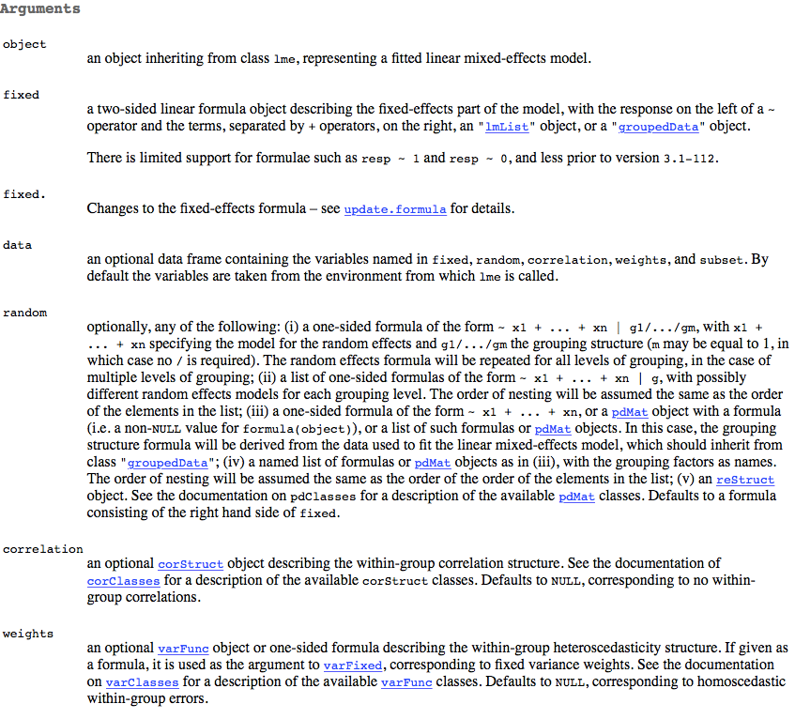
lme()

Slide 35
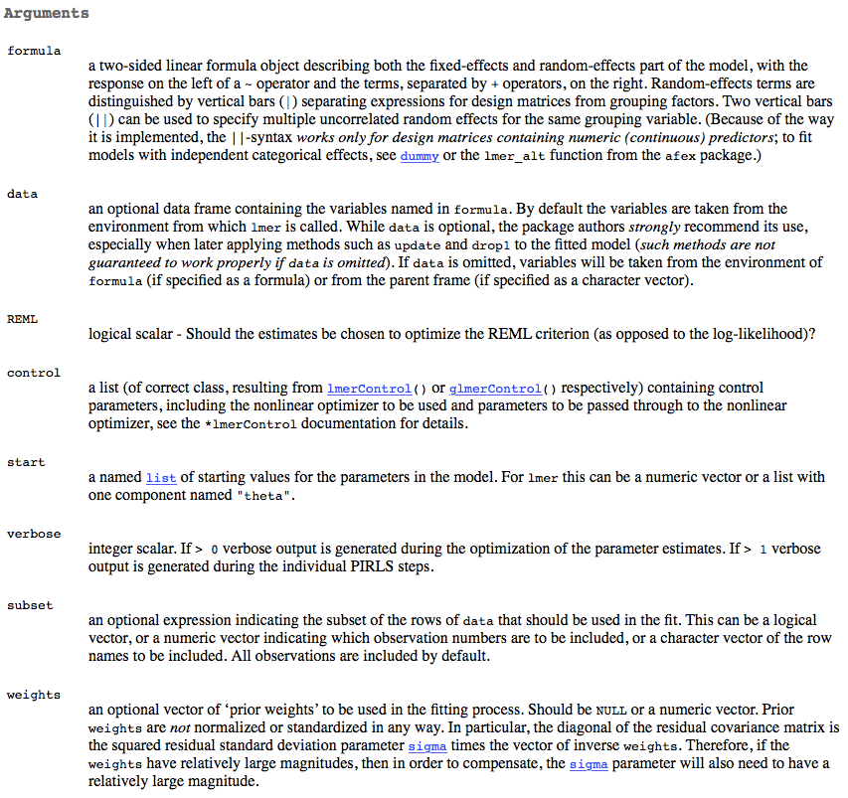
lmer()

Slide 36
So far so good?
Any questions?
Ready to move on?

Slide 37
Zuur et al. (2007 - Analysing Ecological Data) They measured benthic species richness in nine (9) inter-tidal areas along the Dutch coast. For each inter-tidal area, five (5) sites were measured.
Here we will focus on three variables:
Response
Richness of benthic species (No of species, Richness).
Predictors
Height of a sampling station compared to mean tidal level (in cm, NAP)
Exposure (a High/Low index summarising wave action, length of the surf zone, slope, grain size, and the depth of the anaerobic layer, Exposure).
QUESTION TO ANSWER:
Does species richness changes as a function of exposure and NAP?

Slide 38
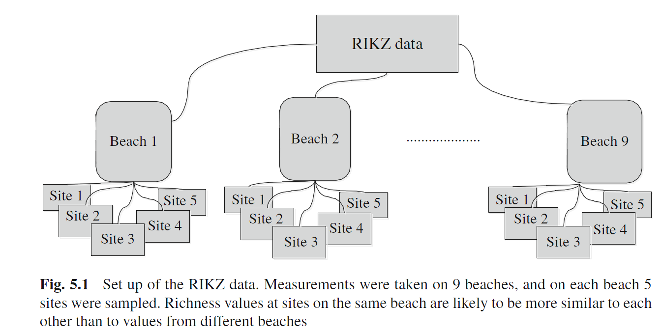
Mixed Effects Models Practical aspects (Design)
Hierarchical sampling design
Sites NESTED within Beach
Individual observations are not replicates
Problem: Observations (sites) within beaches not independent
Solution: Include the sampling design as part of the model

Slide 39
The procedure
Applying a model without a controlling for sampling design.
Use graphical tools to asses problems with the pseudo-replication in the sample design.
Build models that control for the pseudo-replication in the sample design.
Assess which model is the best in control for the pseudo-replication in the sample design problem.
Select the best combination of predictors.

Slide 40
Does Richness changes a a function of NAP and Exposure?
Yes!!, Species richness decreases as a function of NAP and Exposure
> LM.1<-lm(Richness ~ NAP * fExp, data = RIKZ)
> summary(LM.1)
Call:
lm(formula = Richness ~ NAP * fExp, data = RIKZ)
Residuals:
Min 1Q Median 3Q Max
-5.9289 -1.3930 -0.3001 0.9302 11.2329
Coefficients:
Estimate Std. Error t value Pr(>|t|)
(Intercept) 8.9216 0.7049 12.657 9.50e-16 ***
NAP -3.6689 0.6806 -5.391 3.17e-06 ***
fExp11 -5.3043 1.0827 -4.899 1.55e-05 ***
NAP:fExp11 2.1771 1.0362 2.101 0.0418 *
---
Signif. codes: 0 ‘***’ 0.001 ‘**’ 0.01 ‘*’ 0.05 ‘.’ 0.1 ‘ ’ 1
Residual standard error: 3.379 on 41 degrees of freedom
Multiple R-squared: 0.5752, Adjusted R-squared: 0.5441
F-statistic: 18.5 on 3 and 41 DF, p-value: 9.591e-08
Is a lm the best approach to model this relation?
Not a simple answer
Depends on → Sampling design and the structure of errors

Slide 41
Mixed Effects Models Practical aspects (Variance)
Is there a structure in the residuals variability?
Heteroscedasticity
Pseudo replication

Slide 42

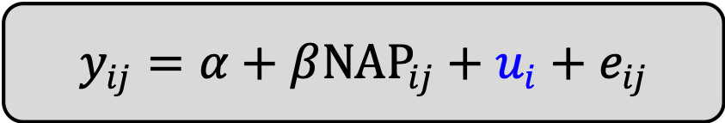
Mixed Effects Models Equation Notation
Random Intercept
model:
$$y_{ij}=α+β{NAP}_{ij}+u_{i}+e_{ij}$$
species richness at beach i and site j
fixed overall intercept
fixed overall slope
random intercept for beach i
residuals
This results in
nine (9) intercepts $\left[α+u_{i1}\right]$

Slide 43
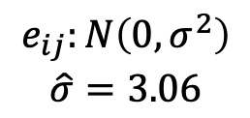
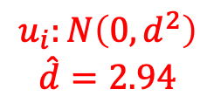
Mixed Effects Models R - implementation
Random Intercept
model with lme
> Mlme1 <- lme(Richness ~ NAP, random = ~1 | fBeach,
+ data = RIKZ)
> summary(Mlme1)
Linear mixed-effects model fit by REML
Data: RIKZ
AIC BIC logLik
247.4802 254.525 -119.7401
Random effects:
Formula: ~1 | fBeach
(Intercept) Residual
StdDev: 2.944065 3.05977
Fixed effects: Richness ~ NAP
Value Std.Error DF t-value p-value
(Intercept) 6.581893 1.0957618 35 6.006682 0
NAP -2.568400 0.4947246 35 -5.191574 0
Correlation:
(Intr)
NAP -0.157
$$u_{i}:N\left(0,d^{2}\right)$$
$$\hat{d}=2.94$$
$$e_{ij}:N\left(0,σ^{2}\right)$$
$$\hat{σ}=3.06$$

Slide 44
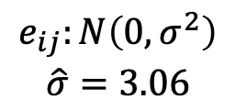

Mixed Effects Models R - implementation
Random Intercept
Model with lmer
> Mlme2 <- lmer(Richness ~ NAP + (1 | fBeach),
+ data = RIKZ, REML = TRUE )
> summary(Mlme2)
Linear mixed model fit by REML ['lmerMod']
Formula: Richness ~ NAP + (1 | fBeach)
Data: RIKZ
REML criterion at convergence: 239.5
Scaled residuals:
Min 1Q Median 3Q Max
-1.4227 -0.4848 -0.1576 0.2519 3.9794
Random effects:
Groups Name Variance Std.Dev.
fBeach (Intercept) 8.668 2.944
Residual 9.362 3.060
Number of obs: 45, groups: fBeach, 9
Fixed effects:
Estimate Std. Error t value
(Intercept) 6.5819 1.0958 6.007
NAP -2.5684 0.4947 -5.192
$$u_{i}:N\left(0,d^{2}\right)$$
$$\hat{d}=2.94$$
$$e_{ij}:N\left(0,σ^{2}\right)$$
$$\hat{σ}=3.06$$

Slide 45
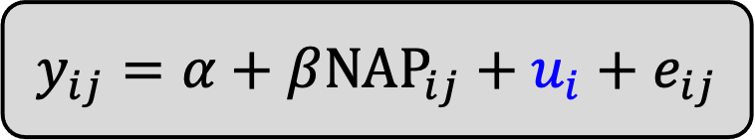
Mixed Effects Models R - implementation
$$y_{ij}=α+β{NAP}_{ij}+u_{i}+e_{ij}$$
Random Intercept
model:
Extract the random effects from lme
> ranef(Mlme1)
(Intercept)
1 2.621519
2 5.199608
3 -2.615780
4 -2.275618
5 1.950179
6 -1.629402
7 -1.765477
8 -1.061665
9 -0.423364
u_{i}

Slide 46
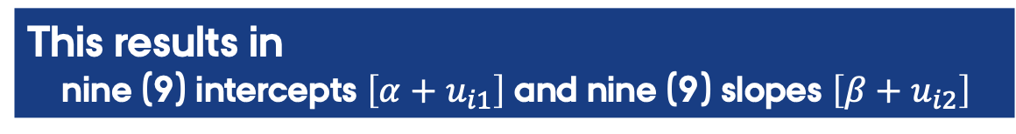
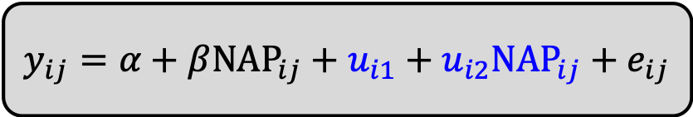
Mixed Effects Models Equation Notation
Random Intercept
and slope model:
$$y_{ij}=α+β{NAP}_{ij}+u_{i1}+u_{i2}{NAP}_{ij}+e_{ij}$$
species richness at beach i and site j
fixed overall intercept
fixed overall slope
random intercept for beach i
random slope for beach i
residuals
This results in
nine (9) intercepts $\left[α+u_{i1}\right]$ and nine (9) slopes $\left[β+u_{i2}\right]$

Slide 47
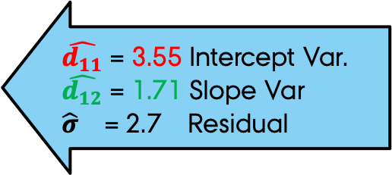
Mixed Effects Models R - implementation
Random Intercept & slope model
with lme
> Mlme1b <- lme(Richness ~ NAP, random = ~NAP | fBeach,
+ data = RIKZ)
> summary(Mlme1b)
Linear mixed-effects model fit by REML
Data: RIKZ
AIC BIC logLik
244.3839 254.9511 -116.1919
Random effects:
Formula: ~NAP | fBeach
Structure: General positive-definite, Log-Cholesky parametrization
StdDev Corr
(Intercept) 3.549064 (Intr)
NAP 1.714963 -0.99
Residual 2.702820
Fixed effects: Richness ~ NAP
Value Std.Error DF t-value p-value
(Intercept) 6.588706 1.264761 35 5.209448 0e+00
NAP -2.830028 0.722940 35 -3.914610 4e-04
$\hat{d_{11}}$ = 3.55 Intercept Var.
$\hat{d_{12}}$ = 1.71 Slope Var
$\hat{σ}$ = 2.7 Residual

Slide 48
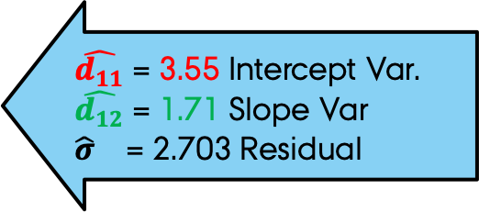
Mixed Effects Models R - implementation
Random Intercept & slope model with lmer
> Mlme2b <- lmer(Richness ~ NAP + (NAP | fBeach),
+ data = RIKZ, REML = TRUE )
> summary(Mlme2b)
Linear mixed model fit by REML ['lmerMod']
Formula: Richness ~ NAP + (NAP | fBeach)
Data: RIKZ
REML criterion at convergence: 232.4
Scaled residuals:
Min 1Q Median 3Q Max
-1.8212 -0.3410 -0.1674 0.1925 3.0397
Random effects:
Groups Name Variance Std.Dev. Corr
fBeach (Intercept) 12.600 3.550
NAP 2.942 1.715 -0.99
Residual 7.307 2.703
Number of obs: 45, groups: fBeach, 9
Fixed effects:
Estimate Std. Error t value
(Intercept) 6.5884 1.2649 5.208
NAP -2.8301 0.7231 -3.914
$\hat{d_{11}}$ = 3.55 Intercept Var.
$\hat{d_{12}}$ = 1.71 Slope Var
$\hat{σ}$ = 2.703 Residual

Slide 49
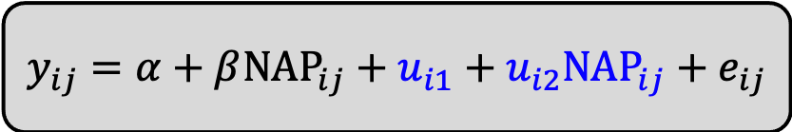
Mixed Effects Models R - implementation
Random Intercept
and slope model:
$$y_{ij}=α+β{NAP}_{ij}+u_{i1}+u_{i2}{NAP}_{ij}+e_{ij}$$
Extract the random effects lme
> ranef(Mlme1b)
(Intercept) NAP
1.8323503 -0.8262398
5.7747909 -2.7067858
-2.7820638 1.3243120
-3.0262848 1.4440673
4.6114440 -2.3072951
-2.1624275 1.0543530
-2.5057621 1.1856990
-1.4888117 0.7231759
-0.2532354 0.1087136
u_{i 1}=
= u_{i 2}

Slide 50
Which random structure is better?
> anova(Mlme1,Mlme1b)
Model df AIC BIC logLik Test L.Ratio p-value
Mlme1 1 4 247.4802 254.5250 -119.7401
Mlme1b 2 6 244.3839 254.9511 -116.1919 1 vs 2 7.096378 0.0288
Random Intercept
model [Mlme1]
Random Intercept/Slope model [Mlme1b]
This is a model comparison problem
This can be done using...
AIC/BIC criteria
AND
Log-likelihood ratio test

Slide 51
So far so good?
Any questions?
Ready to move on?

Slide 52
Mixed Effects Models Model selection (part 1)
Step -1
Fit a FULL model of ONLY fixed effects with the function gls()
This model represent of the Null hypothesis
[H_{o}= NO need for random effects]
B1 <- gls(Richness ~ 1 + NAP * fExp,
method = "REML", data = RIKZ)
Full = all possible fixed effects
Estimate parameters using REML

Slide 53
Mixed Effects Models Model selection (part 1)
Step 2
Fit FULL models of fixed effects and random effects with lme()
This model represent of the alternative hypothesis
[H_{A}= need for random effects]
# Random intercept
B2 <- lme(Richness ~1 + NAP * fExp, data = RIKZ,
random = ~1 | fBeach, method = "REML")
# Random slope
B3 <- lme(Richness ~ 1 + NAP * fExp, data = RIKZ,
random = ~1 + NAP | fBeach, method = "REML")
Estimate parameters using REML

Slide 54
Mixed Effects Models Model selection (part 2)
Step 3
Select the best random structure
Use the AIC criteria (lowest the better)
AIC(B1, B2, B3)
df AIC
B1 5 238.5329
B2 6 236.4925
B3 8 237.1331
Lowest AIC → the best model

Slide 55
Mixed Effects Models Model selection (part 3a)
Step 3a
Simply fixed effects by removing non-significant or marginally significant terms
> summary(B2)
Linear mixed-effects model fit by REML
Data: RIKZ
AIC BIC logLik
236.4925 246.7739 -112.2462
Random effects:
Formula: ~1 | fBeach
(Intercept) Residual
StdDev: 1.818579 2.942872
Fixed effects: Richness ~ 1 + NAP * fExp
Value Std.Error DF t-value p-value
(Intercept) 8.861084 1.0208453 34 8.680144 0.0000
NAP -3.463651 0.6278583 34 -5.516613 0.0000
fExp11 -5.255617 1.5452298 7 -3.401188 0.0114
NAP:fExp11 2.000464 0.9461259 34 2.114374 0.0419

Slide 56
Mixed Effects Models Model selection (part 3b)
Step 3B
Test of the simple model is better than an full model fixed effects
Here the null hypothesis is that the simple model is the same as the complex model.
B2a <- lme(Richness ~ NAP*fExp , data = RIKZ,
random = ~1 | fBeach, method="ML")
B2b <- lme(Richness ~ NAP+fExp , data = RIKZ,
random = ~1 | fBeach, method="ML")
anova(B2a,B2b)
Model df AIC BIC logLik Test L.Ratio p-value
B2a 1 6 242.1135 252.9535 -115.0567
B2b 2 5 244.7589 253.7922 -117.3795 1 vs 2 4.645431 0.0311
Note the use of ML!
This is a model comparison problem
This can be done using...
AIC/BIC criteria AND Log-likelihood ratio test

Slide 57
Mixed Effects Models Model selection (part 3b)
> B2b <- lme(Richness ~ NAP+fExp , data = RIKZ,
+ random = ~1 | fBeach, method="ML")
> B2c <- lme(Richness ~ NAP , data = RIKZ,
+ random = ~1 | fBeach, method="ML")
> B2d <- lme(Richness ~ fExp , data = RIKZ,
+ random = ~1 | fBeach, method="ML")
> anova(B2b,B2c)
Model df AIC BIC logLik Test L.Ratio p-value
B2b 1 5 244.7589 253.7922 -117.3795
B2c 2 4 249.8291 257.0557 -120.9145 1 vs 2 7.070141 0.0078
> anova(B2b,B2d)
Model df AIC BIC logLik Test L.Ratio p-value
B2b 1 5 244.7589 253.7922 -117.3795
B2d 2 4 265.4332 272.6599 -128.7166 1 vs 2 22.6743 <.0001
NAP AND fExp
NAP
fExp
Should we keep NAP?, what about fBeach?

Slide 58
Mixed Effects Models Model selection (part 4)
Step 4
Model Validation
> B4 <- update(B2,~.-NAP:fExp)
> summary(B4)
Linear mixed-effects model fit by REML
Data: RIKZ
AIC BIC logLik
240.5538 249.2422 -115.2769
Random effects:
Formula: ~1 | fBeach
(Intercept) Residual
StdDev: 1.907175 3.059089
Fixed effects: Richness ~ NAP + fExp
Value Std.Error DF t-value p-value
(Intercept) 8.601088 1.0594875 35 8.118158 0.0000
NAP -2.581708 0.4883901 35 -5.286160 0.0000
fExp11 -4.532777 1.5755610 7 -2.876929 0.0238

Slide 59
Mixed Effects Models Model selection (part 4)
Is there a structure in the residuals variability?
Heteroscedasticity

Slide 60
So far so good?
Any questions?
Ready to finish?

Slide 61
In summary
Mixed-effect models that control for pseudo replication can be build by allowing
Intercepts to vary – Random intercept model
Intercepts and the slopes to vary - Random slope-intercept
lme(Y~Fix.Eff,random=~1+Fix.Eff|Rand.Eff,data=data.In)

Slide 62
In summary
Model selection in mixed models is a two step process:
Part one – define the best random and/or variance structure
Models build using REML
Part two – define the best fixed effect structure
Models build using ML

